Slide 1

Social enterprise to create digital ambassadors

Slide 2



Agenda :
  Whats Coyolia and its vision?
  Founders
  List of services and products that we can offer
  OEM partners.

Slide 3
Coyolia: Cohort of Young Leaders in Action
Coyolia will create abundant opportunities for youth employment across India and Africa. We will harness open-source IP in digitalization of communities
Mission statement of COYOLIA
We will be the Digital Ambassador, a bridge between communities, govt and industry. A facilitator for adoption of solutions made by open-source, freeware under DPGA [Digital Public Goods Alliances]. We will impact local employment for youth by combination of leadership and technical skills. We will be the cohort of choice for young leaders

Slide 4
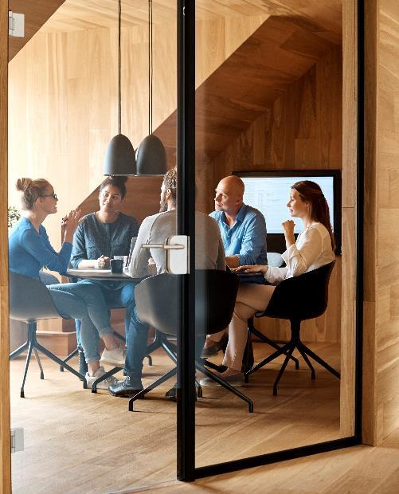




Founders

Slide 5
Founders
Avinash Kulkarni, founder CEO, 29 years of work experience in large corporates like Xerox, Hitachi, RIL, IL&FS. Exposure to not- for- profit sector and startups. Expertise on cloud, IT infra, sales training and global alliances
Ravikanth Taduri, 21 years of experience in mid market companies as Head of HR and business partner. Expertise on SOPs, organization culture and organization building for IT/ITES companies.
Sudhir Kutty, 28 years of experience in large corporate like TTSL, RIL, HCL. Telecom sales and retail sales. Current expertise is in GIS solutions, logistics planning and FMCG distribution

Slide 6

List of services and products

Slide 7

Skill development and courses
AMBAR GLOW program: undergraduates, 18-22 age group, a blend of Domain knowledge, core technology and communication. 50-100 hours module
Basics and advanced skills on designing solutions on cloud, IOT, data mesh, data analytics. 10-20 hours modules
PLC related and mechanical concepts for engineering through partnership with ARSDC [Amararaja batteries group] Plumbing, HVAC, electrician courses for rural youth with labs, mock setups
Courses and consulting from IIT Madras through partnership with IITM Pravarthak [proposed]
Business English, leadership in association with Head Held High Foundation
Notes:
Problem: aeroplane window shape, Risk taking: AIR BNB, listening: an art that test understands is linked with leadership, financial – MF, FD, banks, cards

Slide 8
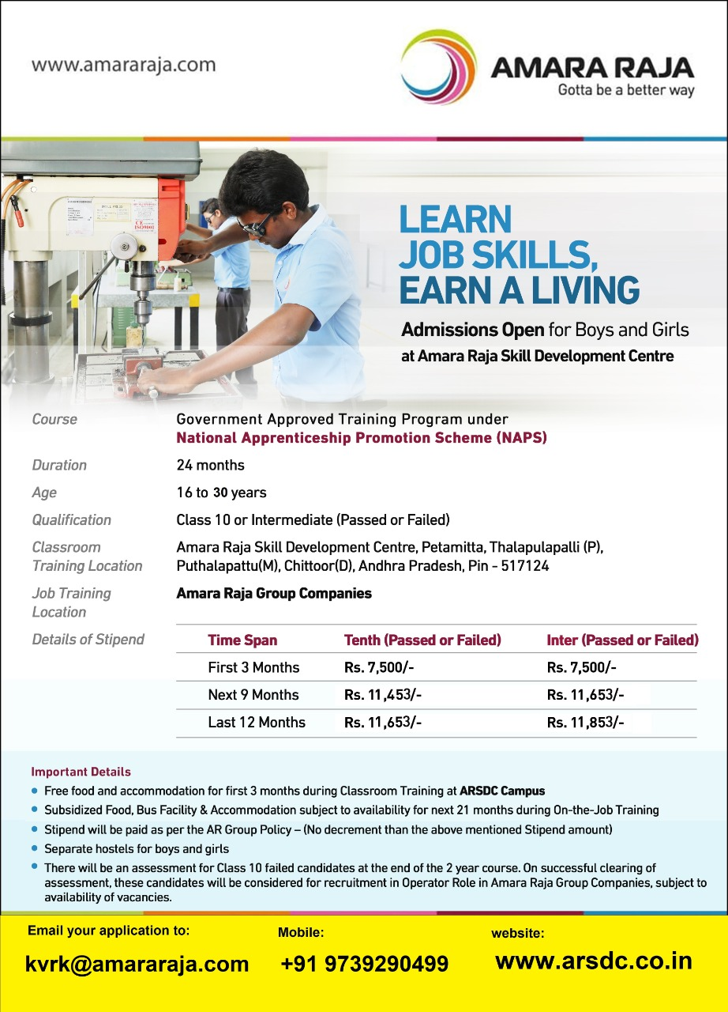

Slide 9
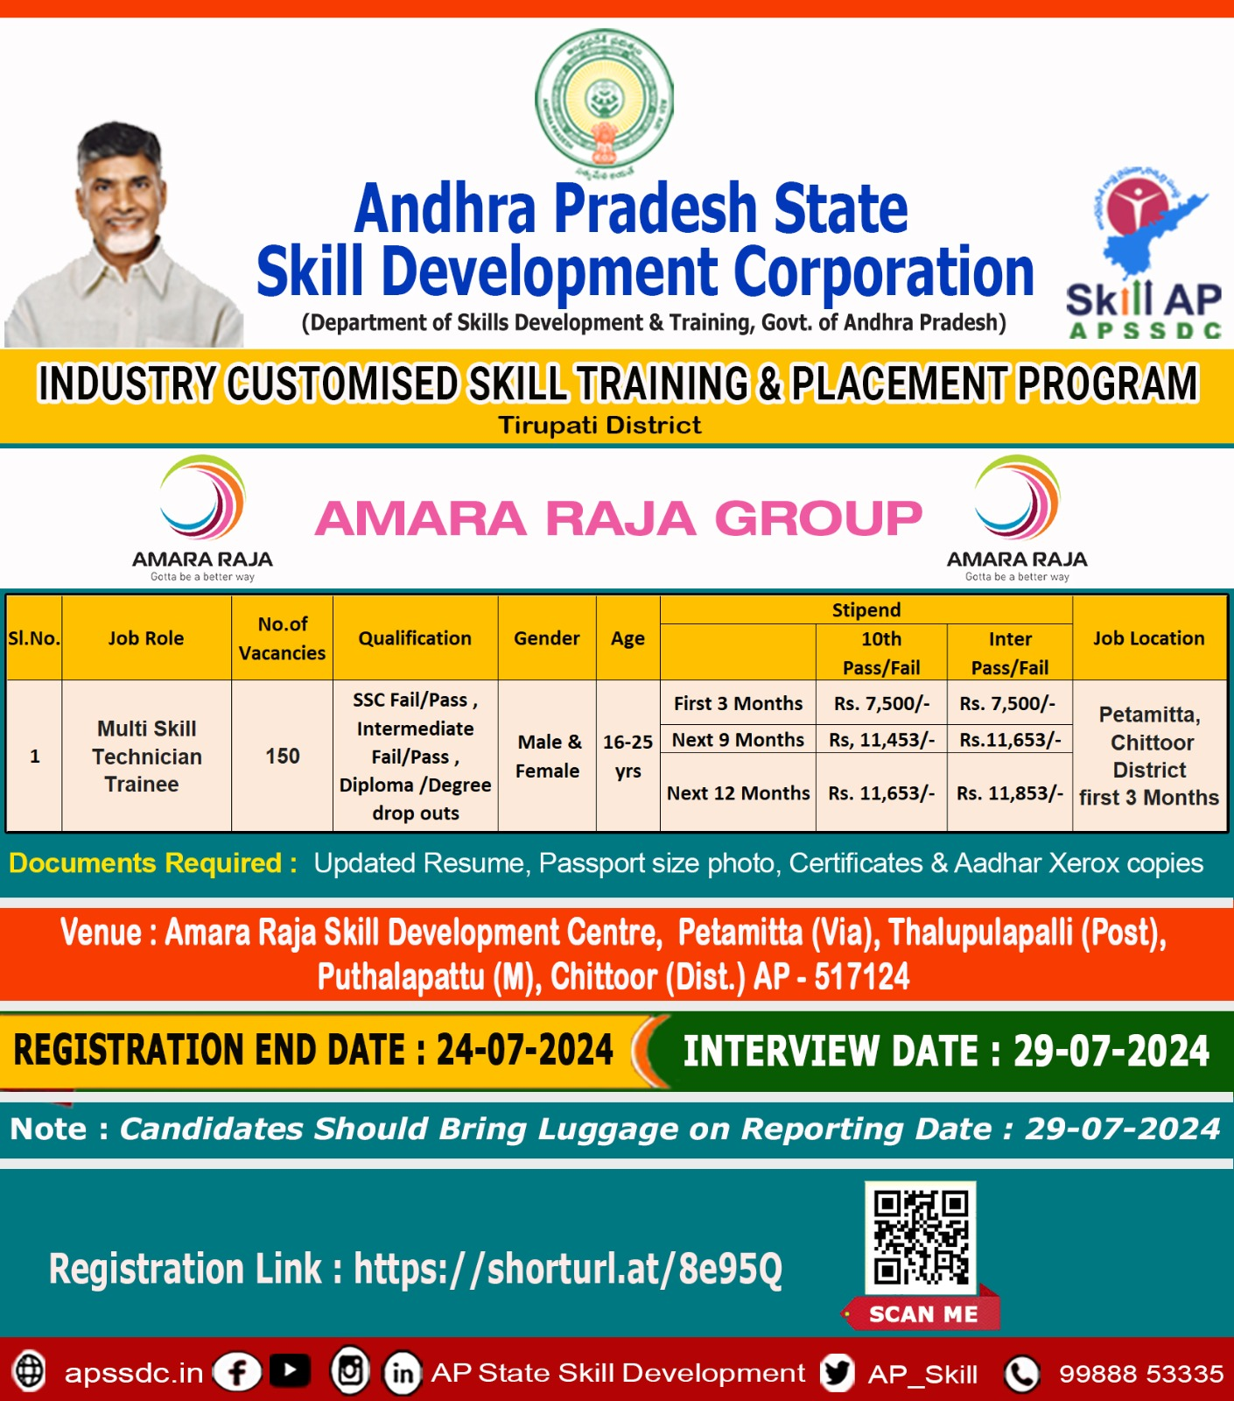

Slide 10
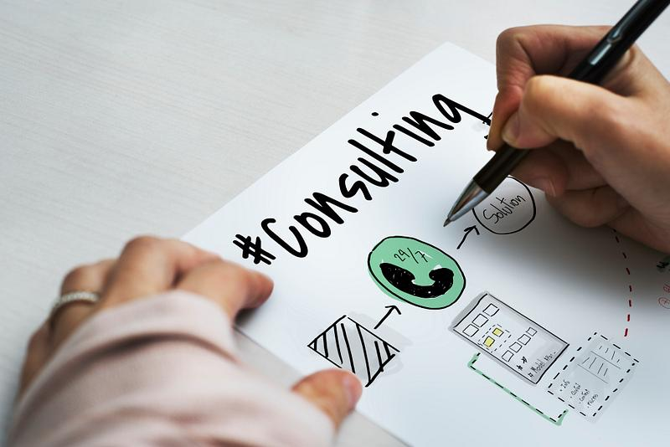
Consulting services: future readiness of IT
Prepare the ground for future readiness. Information pipeline, adoption of AI, LLM/SLM and analysis of LLM/SLM models Data mesh architecture, data extraction and modeling and data dashboards –complete cycle of data governance
Data migration and modernization of apps/DB, on premise or on cloud
Implementation of voice biometrics and voice authentication solutions
Quantum computing –gap assessment , current security flaws, services, roadmap, readiness towards breaking of code by quantum
Adoption of IOT, product prototype development and inclusion of PLC + Industrial IOT
GIS: 1) Lidar works, ( Classification of Lidar data, 3dDigitization). 2) Telecom projects ( Micro station, AutoCAD, GIS, As-built Drawing update )

Slide 11
Consulting panel
Aniruddha Deswandikar is a seasoned Technologist with over 31 year of experience across startups, consulting, Netflix and Microsoft. He spent 13 years as a developer before starting his journey as an Architect at Microsoft. At Microsoft he spent 18 years at Microsoft across multiple roles; Architect, Principal Architect and Director of Microsoft Technology Center at Bangalore.. He started his Architecture journey as an Apps and Infra architect and in last five years expanded into Data and AI. For the last 3 years at Microsoft he helped large multinational companies like AB-InBev, UCB Pharma and others to migrate their Central Analytical Platforms to a Data Mesh architecture. This experience inspired him to a write a book titled "Engineering Data Mesh on Azure Cloud" (https://tinyurl.com/dmazpackt).

Slide 12
Consulting panel …2
Amita Jain/RM/Tata Trusts for CSR projects, rural migration policy and govt policy making
Chaitanya Gajulaa/AWS senior architect, certified on GCP, Azure for multi cloud migrations
Shoba Pai and Rajani Adikari/ English language for trainers, working prof
Mira Vempati/ trainer and expert on legal compliances such as POSH
Sudhir M and Mani from LYTA/IOT prototyping engineers and trainers

Slide 13
Partners & models

Slide 14

IITM Pravarthak Chennai for quantum computing consulting, cyber security assessments and courses on AI/ML/analytics/IIOT. [proposed]
Amararaja batteries supported ARSDC Chittoor for PLC, IOT, mechanical –electrical short courses.
Head Held High Foundation Bangalore as execution partner for soft skills and CSR partner
Infiniyx Bangalore for networking and telecom solutions
World Startup Forum Netherlands for mentoring and startup acceleration
GIS international Hyderabad
E-gov Foundation for DIGIT Framework /open source freeware

Slide 15

What are our delivery models?
Short term skilling for existing staff on T&M basis, executed on premises for SMB/corporate.
Online courses for 3-5 days only for working professionals, with instructor led, self learning and canned lessons on LMS
Instructor led programs in labs created for IOT, PLC at ARSDC , Chittoor AP. Amararaja Batteries group
Consulting assignments based on scope of work with optional post SRS implementation. Specific frameworks from AWS – well architected review on six principles including sustainability, Azure
Staff augmentation for companies’: laterals, fresher hiring [train, certify before hiring] and project based temporary hiring

Slide 16
Cloud service details

Slide 17
Bouquet of services offered on cloud
Managed services
Modernization
Migration
Migration – Migration is a detailed effort to study, report various needs of an application/DB [assessment stage], prove the efficacy through POC [landing zone stage] and move it to any cloud [lift and shift stage]. AWS adoption Framework
Managed Services – post migration customers need inexpensive, remote team for 24/7 monitoring of the IT infra.
Modernization – Customer applications and databases that are on “End of life or end of support”, may need re-platforming. Legacy applications built on mainframe, Z O/S, may need re-engineering. We refresh it with “ micro services architecture”

Slide 18
What’s application modernization?
Migrating legacy applications and legacy databases to new platforms
Triggers: Customers need to change the business applications running on more than 10-year-old legacy platform , home grown applications, mainframe/COBOL/VB/dotnet based apps and Windows 2008 /MS SQL 2012 DB
Benefits: Enhanced security features if this is re-engineered and made to work on Java/Linux/dotnet core/other platforms. Scalable as it will be microservices based and can be deployed on any cloud, any VM.
Costs and time: Modernization is custom built migration projects that are specific to each deployment. Different tools can create microservices APIs for old applications, without rip-replace, in 2 weeks. GEN AI solutions for legacy apps and modern data stack with AI for DB migration /modernization
Expensive DB licenses that can be migrated to cloud-based RDBMS services
GEN AI for source code migration
Legacy applications that need new architecture for micro-services

Slide 19


Thank You
Avinash@coyolia.com,
Ravikanth@coyolia.com
Sudhir@coyolia.com
www.coyolia.com. www.ambarglow.com
+91-9739005000

